Slide 1
Task adaptation IN real-time & embedded systems FOR ENERGY & RELIABILITY TRADEOFFS
Sathish Gopalakrishnan
Department of Electrical & Computer Engineering
The University of British Columbia
sathish@ece.ubc.ca

Slide 2
Why should we care about task adaptation in embedded systems?

Slide 3
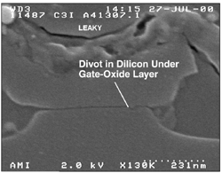
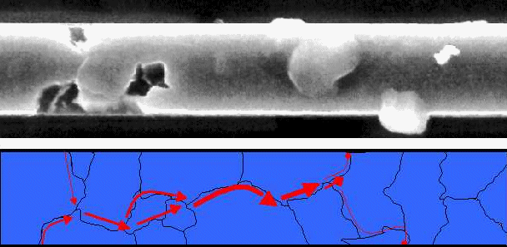
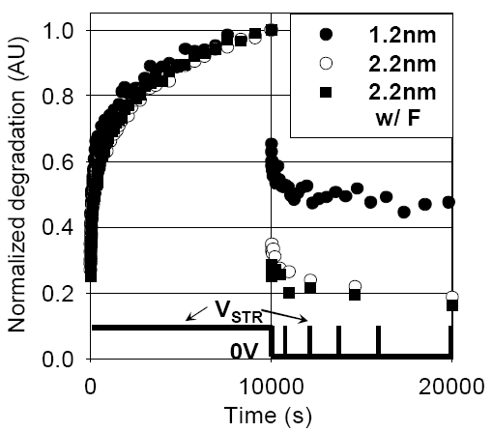
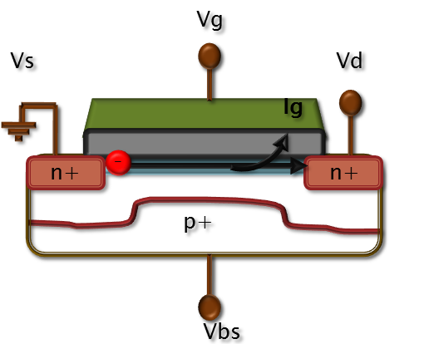
Intermittent Faults
40% of the real-world failures in a processor caused by intermittent faults [Nightingale et al., Eurosys 2011]
SDB
Electromigration
NBTI
HCI
Notes:
Add manufacturing defects and design errors.

Slide 4
Characterization
Intermittent errors are a serious concern, we need to know more about them.
How do they affect programs?
What are the properties of effective error tolerance techniques?

Slide 5
Characterization: Fault Model
tA
tI
Length (tL)
Active duration (tA)
Location (unit)
Microarchitectural model
tL
Fault Mechanism | Gate-level models | Microarchitectural modelling
Gate-oxide breakdown | Intermittent delay | Intermittent stuck-at-last-value
Negative bias temperature instability | Intermittent delay | Intermittent stuck-at-last-value
Hot carrier injection | Intermittent delay | Intermittent stuck-at-last-value
Electromigration | Intermittent delay Intermittent open Intermittent short | Intermittent stuck-at-last-value Intermittent stuck-at-zero/one Dominant-0/1 bridging
Manufacturing defects | Intermittent open Intermittent short | Intermittent stuck-at-zero/one Dominant-0/1 bridging

Slide 6
Characterization: Experimental Setup
6
We used the SPEC2006 benchmark suite.
Modify Microarchitectural-level simulator.
Microarchitectural Simulator
+
Fault Model
Fault start
Error Propagation Set
Crash Distance
Crash
6

Slide 7
Characterization: Experimental Setup
7
We used the SPEC2006 benchmark suite.
Modify Microarchitectural-level simulator.
Microarchitectural Simulator
+
Fault Model
Fault start
Program End
Program Output
Silent Data Corruption

Slide 8
Characterization: Experimental Setup
8
We used the SPEC2006 benchmark suite.
Modify Microarchitectural-level simulator.
Microarchitectural Simulator
+
Fault Model
Fault start
Program End
Program Output
Benign Fault

Slide 9
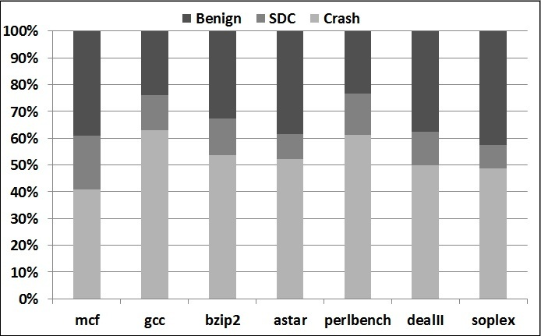
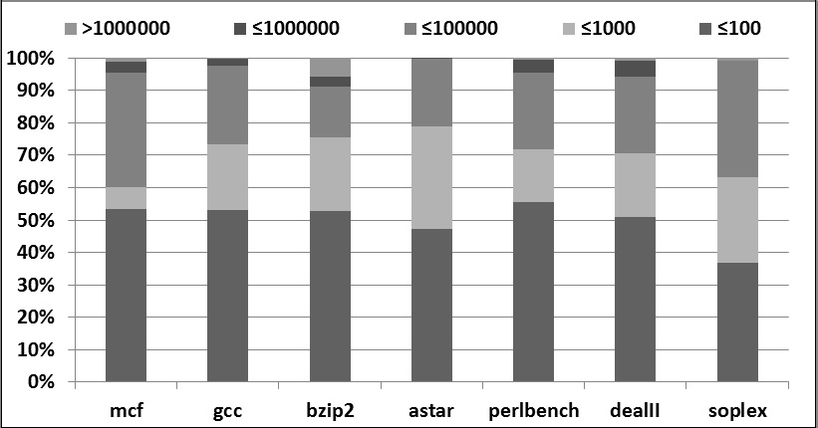
Characterization: Results
How do they affect programs?
Between 41% and 63% led to program crashes.
96% of the crash-causing errors led to crash within 100K dynamic instructions.

Slide 10
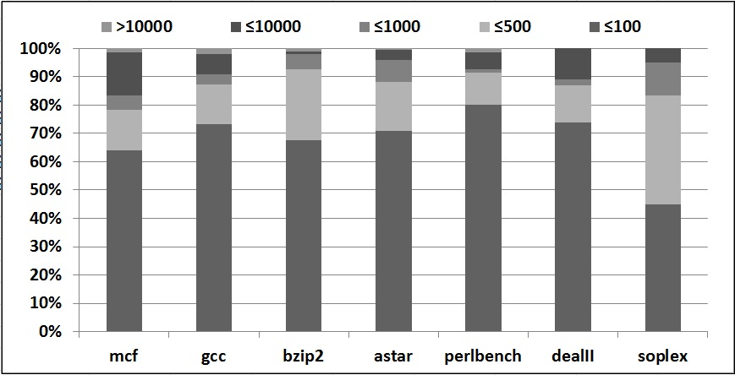
Characterization: Results
How do they affect programs?
88% of the crash-causing errors corrupt <500 data values.
Intermittent errors have serious impact on programs and require diagnosis and recovery mechanisms.

Slide 11
ON TO TASK ADAPTATION

Slide 12
Real-time systems
Need to meet timing constraints:
Typically in the form of deadlines;
Often requires that tasks not exceed time budgets.
Real-time and embedded systems are resource-constrained:
Limited processing power;
Energy consumption.

Slide 13
Transformations for resource-constrained systems
Program transformations that yield:
Shorter execution times;
Reduced energy consumption;
Increased reliability.

Slide 14
Traditional Program Transformation
Transformation
.c
.c
≡

Slide 15
Non-Traditional Program Transformation
Transformation
.c
.c
≅

Slide 16
Loop Perforation of Motion Estimation in x264
Reference Frame
Current Frame
?
(Misailovic, et al.)
Notes:
Most loops that we were able to identify were in the subcomputation that performs motion estimation.
Motion estimation is the technique instrumental for video compression. It matches similar blocks on both current and reference frame. For example if we want to identify the swimmer in the reference frame, the motion estimator compares different parts of the reference frame. The position of the surfer might have changed, either due to the movement of the surfer, or of the camera. After comparing with multiple blocks on a reference frame, the most similar block is selected. The part of the reference frame that best matches the current frame is finally selected.
-------------------
Motion estimation: describe the transformation from one 2D image to another (wiki: http://en.wikipedia.org/wiki/Motion_estimation)
Encoder performs both intra- and inter- frame compression. For reference frames only intra-frame compression is performed (Consequently, they consume more space). When encoding the following frames, the encoders tries to find the differences from the reference frame. Motion estimation describes the difference between the parts (blocks) of two frames caused by the movement of bodies or the camera (pan/zoom/tilt). For example, when we want to find the position of the swimmer in the reference frame, we in general have to check different parts of the reference frame. Then the part of the reference frame that is the most similar to the swimmer is selected, and only the distance vector is stored, thus saving considerable space
=====================================================
**GOAL**
Explain what motion estimation is

Slide 17
Loop Perforation
int motion_estimation(block_t[] blocks, int n)
{
int idx = 0, best = INT_MAX, num_iters = 0, i = 0;
while (i < n) {
int cur = compute_distance(blocks[i]);
if (cur < best) {
idx = i;
best = cur;
}
num_iters = num_iters + 1;
i = i + 1;
}
assert (0 <= idx < n);
return idx;
}

Slide 18
Loop Perforation
int motion_estimation(block_t[] blocks, int n)
{
int idx = 0, best = INT_MAX, num_iters = 0, i = 0;
while (i < n) {
int cur = compute_distance(blocks[i]);
if (cur < best) {
idx = i;
best = cur;
}
num_iters = num_iters + 1;
i = i + 2;
}
assert (0 <= idx < n);
return idx;
}

Slide 19
Loop Perforation
int motion_estimation(block_t[] blocks, int n)
{
int idx = 0, best = INT_MAX, num_iters = 0, i = 0;
while (i < n) {
int cur = compute_distance(blocks[i]);
if (cur < best) {
idx = i;
best = cur;
}
num_iters = num_iters + 1;
i = i + 4;
}
assert (0 <= idx < n);
return idx;
}

Slide 20
Quality of Service Profiling
Automatically explore alternate versions
QoS model
Program
Quality of Service profiler
Time Profiler
Subcomputation Transformation
Transformation Evaluation
Input(s)
timing info
performance vs QoS info
Notes:
This situation leads to the following quality of service profiling concept.
Quality of Service profiling explores the space of optimization opportunities by automatically generating potential program optimizations.
Specifically, we first find the time consuming subcomputations, the same way standard profilers do. We then automatically transform each such subcomputation, one at a time. The goal of the transformation is to increase the performance of the subcomputation, and it is allowable for the transformation to induce less accurate result.
We then execute each of the transformed programs, and measure the quality of service loss and the performance. We select those subcomputations which, when transformed, deliver good performance with acceptable quality of service losses. and present them to the developer as good candidates for manual optimization
As we can see, the key element of our technique is a transformation or set of transformations that we perform to obtain alternative subcomputations. In this talk we will present one such transformation...
First, we extend the standard profiling process
Second, we use the
As we can see, the crucial part of our technique is the automatic transformation. Now the major question is, what should our transformation look like?
==================
***GOAL***
Automatic generation of optimization opportunities
Exploration: program TRANSFORMATION Based <<--
ITERATIVE – arrows back ????
multiple boxes... –

Slide 21
Reliability
Failures happen:
Hardware errors;
Software errors/bugs.
Many error detection and recovery techniques exist:
Redundancy and replication;
Recovery blocks;
Memory bounds checking;
…
Reliability mechanisms are considered expensive:
Overheads!

Slide 22
BIG IDEA: Combine program transformations for time savings with transformations for reliability.

Slide 23
BIG IDEA: Combine program transformations for time savings with transformations for reliability AND Allow software developers to specify approximations in cases when they cannot be automatically inferred.

Slide 24
Overview

Slide 25
Framework
Compilation pass built using LLVM/clang;
Runtime built using userspace scheduler over Minix3.

Slide 26
Compilation Pass
Multiple versions based on user-provided approximations (programming language annotations);
Synthesize reliability mechanisms automatically:
Currently restricted to bounds checking and memory padding [1],
Replicated memory allocation in the heap [2],
And replicated execution (software-implemented fault tolerance) [3].
[1] Rx, SOSP 2005 (UIUC)
[2] Samurai, EuroSys 2008 (MSR)
[3] SIFT, DSN 2006 (Princeton)

Slide 27
Runtime System

Slide 28
Minix3 Architecture

Slide 29
Evaluation
Primary interest: Runtime Overhead
Minix3 context switch time ~1.2 microseconds.
With the adaptation framework: ~2.7 microseconds.
But this is only for every new instance of a (periodic) task;
Or can control the time window for adaptation.

Slide 30
Related Work
Program approximation, loop perforation, etc.: Rinard, et al. (MIT)
Programming by Optimization: Hoos et al. (UBC)
And others that I am not emphasizing.

Slide 31
Conclusions
Enabled tradeoff between QoS and reliability;
Framework for performing optimization;
Overheads appear to be acceptable.
Verifiable systems?
Morpheus: Neo, sooner or later you're going to realize just as I did that there's a difference between knowing the path and walking the path.
The Matrix (1999)

